Slide 1
FOOTBALLER EXPLORER
Muhammad Ramadan section 3
CS
Muhammad Anwar
Section 3
CS

Slide 2
Football Explorer
System Idea
the system should help the player to identify his position in the field on the other hand help the coach to (add-edit-delete) new rules and conditions for detection of the position

Slide 3
Representing knowledge
Rules
1
If the player has high speed and high principle of defence
2
If the player has high speed ,under 26 and high principle of defence
3
If the player has high speed ,under 26, high principle of defence and high positioning
4
If the player has high speed ,under 26, high principle of defence, high positioning and high long pass
5
If the player has high speed ,under 26, high principle of defence, high positioning, high long pass and 1-1 situation
Then the player position is a side-back
Then the player position is a side-back
Then the player position is a side-back
Then the player position is a side-back
Then the player position is a side-back

Slide 4
6
If the player has high speed ,under 26, high principle of defence, high positioning, high long pass, 1-1 situation and left leg
7
If the player has high speed ,under 26, high principle of defence, high positioning, high long pass, 1-1 situation and right leg
8
If the player has high strength and under 26
9
If the player has high strength , under 26 and high principle of defence
10
If the player has high strength , under 26, 1-1 situation and high principle of defence
If the player has high strength , under 26, above 26, 1-1 situation and high principle of defence
12
If the player has high strength , under 26, above 26, 1-1 situation, high jump and high principle of defence
13
If the player has high strength , under 26, above 26, 1-1 situation, high jump, high heading and high principle of defence
14
If the player has high strength , under 26, above 26, 1-1 situation, high jump, high heading, left leg and high principle of defence
11
Then the player position is a left-back
Then the player position is a right-back
Then the player position is a center-back
Then the player position is a center-back
Then the player position is a center-back
Then the player position is a center-back
Then the player position is a center-back
Then the player position is a center-back
Then the player position is a center-back

Slide 5
15
If the player has high strength , under 26, above 26, 1-1 situation, high jump, high heading, left leg, right leg and high principle of defence
16
If the player has shoot stopping
17
If the player has shoot stopping and high jump
18
If the player has shoot stopping, above 26 and high jump
19
If the player has shoot stopping, above 26, under 26 and high jump
20
If the player has shoot stopping, above 26, under 26, long ball and high jump
21
If the player has high speed, high principle of attack and right leg
22
If the player has high speed, high principle of attack, under 26 and right leg
23
If the player has high speed, high principle of attack, under 26, high shooting and right leg
Then the player position is a left-wing
Then the player position is a center-back
Then the player position is a goal-keeper
Then the player position is a goal-keeper
Then the player position is a goal-keeper
Then the player position is a goal-keeper
Then the player position is a goal-keeper
Then the player position is a left-wing
Then the player position is a left-wing

Slide 6
24
If the player has high speed, high principle of attack, under 26, high shooting, high dribbling and right leg
25
If the player has high speed, high principle of attack, under 26, high shooting, high dribbling, high running with ball and right leg
26
If the player has high speed, high principle of attack, under 26, high shooting, high dribbling, high running with ball, high positioning and right leg
27
If the player has high speed, high principle of attack, under 26, high shooting, high dribbling, high running with ball, high positioning and left leg
28
If the player has high speed, high principle of attack, under 26, high shooting, high dribbling, high running with ball and left leg
29
If the player has high speed, high principle of attack, under 26, high shooting, high dribbling and left leg
30
If the player has high speed, high principle of attack, under 26, high dribbling and left leg
31
If the player has high speed, high principle of attack, under 26 and left leg
32
If the player has high speed, high principle of attack, high shooting under 26 and left leg
Then the player position is a left-wing
Then the player position is a left-wing
Then the player position is a left-wing
Then the player position is a right-wing
Then the player position is a right-wing
Then the player position is a right-wing
Then the player position is a right-wing
Then the player position is a right-wing
Then the player position is a right-wing

Slide 7
34
If the player has high speed, high principle of attack and left leg
35
If the player has high shooting and high principle of attack
36
If the player has high shooting, high jump and high principle of attack
37
If the player has high shooting, high jump, high heading and high principle of attack
38
If the player has high shooting, high jump, high heading, high finishing and high principle of attack
39
If the player has high shooting, high jump, high strength, high finishing and high principle of attack
40
If the player has high shooting, high jump, high heading, high finishing, high positioning and high principle of attack
Then the player position is a right-wing
Then the player position is a center-forward
Then the player position is a center-forward
Then the player position is a center-forward
Then the player position is a center-forward
Then the player position is a center-forward
Then the player position is a center-forward

Slide 8
41
If the player has high speed, high principle of attack and high ball control
42
If the player has high speed, high principle of attack, high running with ball and high ball control
43
If the player has high speed, high principle of attack, under 26, high short pass, high running with ball and high ball control
44
If the player has high speed, high principle of attack,high dribbling, under 26, high short pass, high running with ball and high ball control
Then the player position is a center-midfield
Then the player position is a center-midfield
Then the player position is a center-midfield
Then the player position is a center-midfield

Slide 9
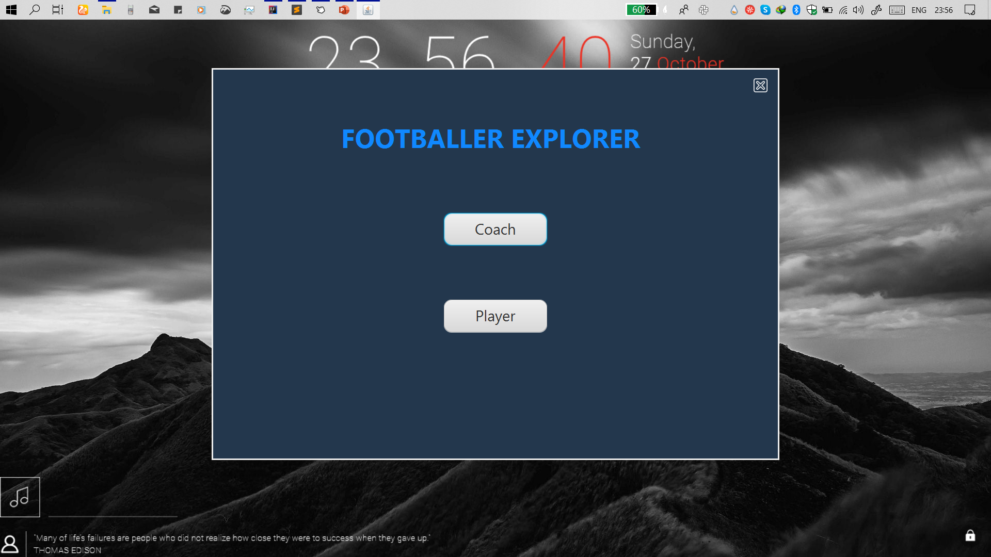

Slide 10
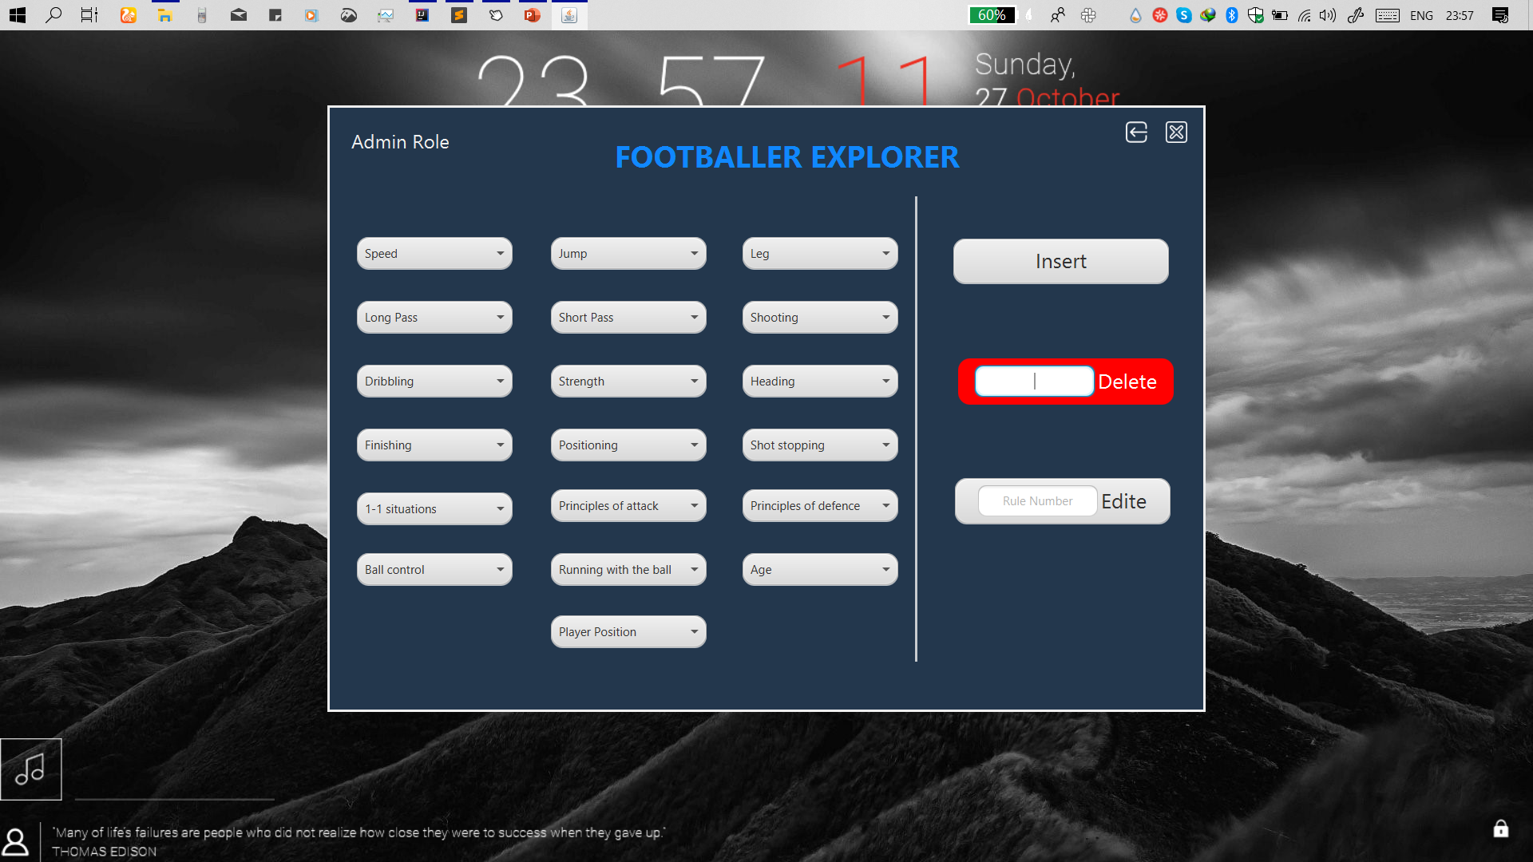

Slide 11
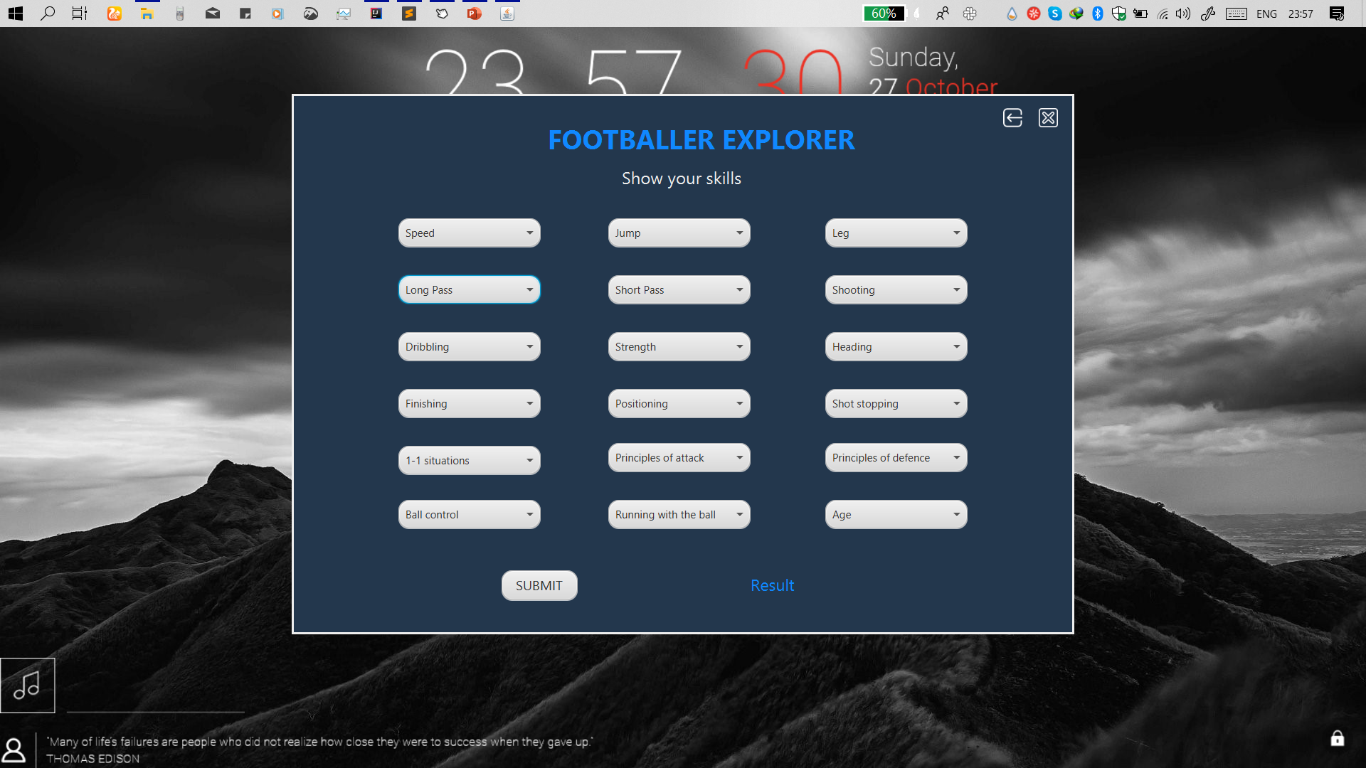

Slide 12

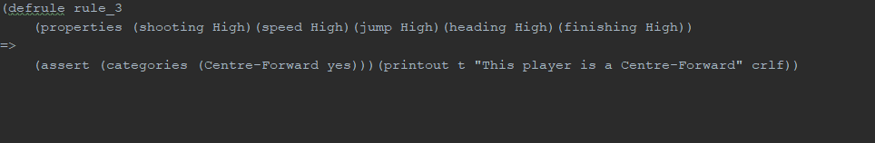
Add the rule 3

Slide 13

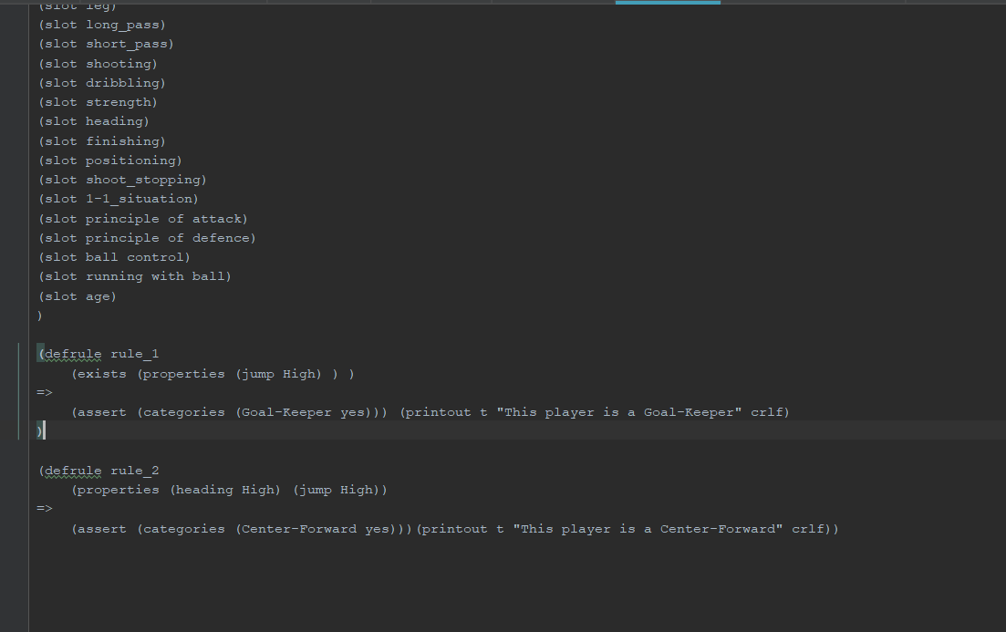
Delete the rule 3

Slide 14
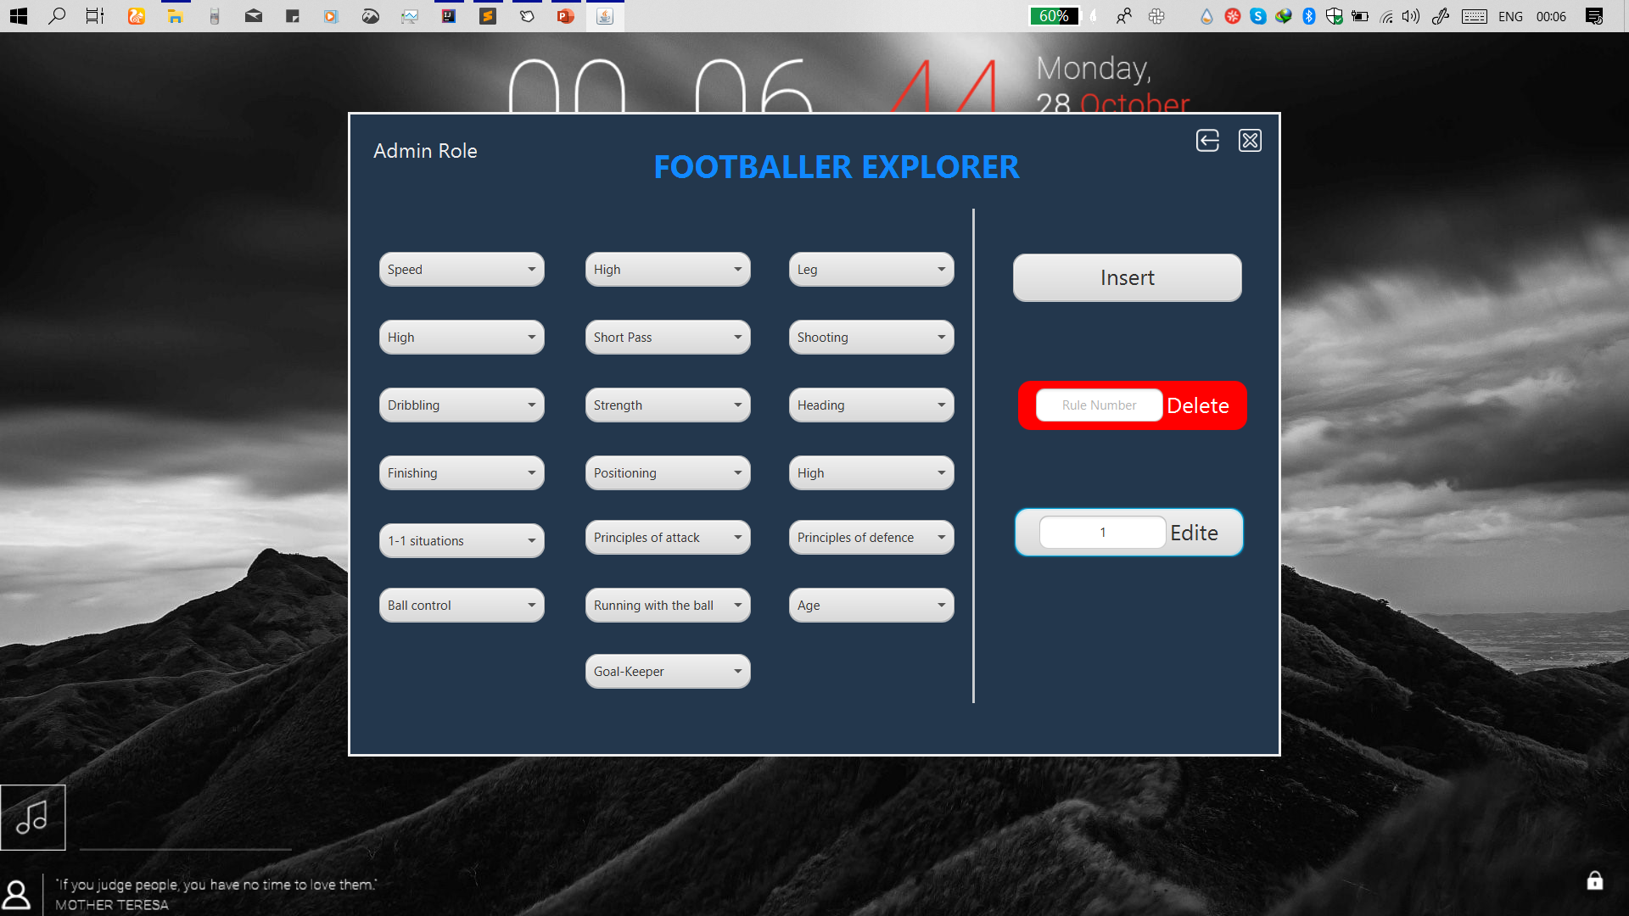
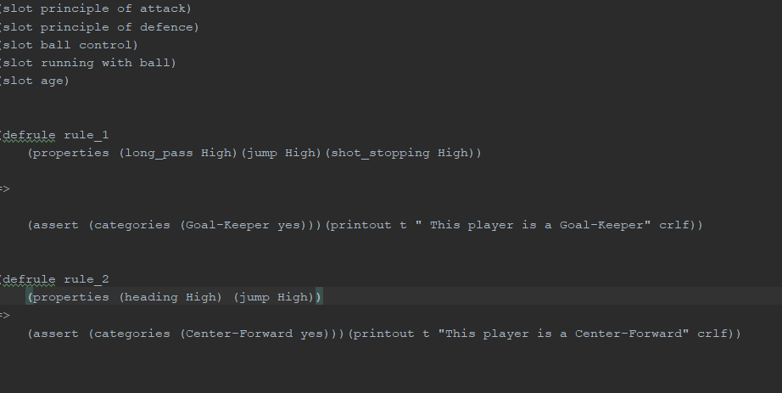
Edit the rule 1

